Slide 1
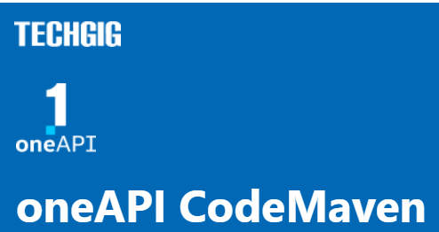
Theme: Predict Consumer Sentiment
Team Name: BlackBird
Team Members: Ashish Anil Waykar
Problem Statement : Problem 1

Slide 2
Theme Chosen and Motivation
The motivation behind creating the above code is to visualize the relationship between google , facebook and Linkedin Sentiment anylasis for a given dataset. The scatter plot allows us to identify any patterns or trends that may exist in the data. The colour property is used to represent the reading score, providing an additional dimension of information to the plot. By changing the colour scale and opacity, we can further customize the visualization to better suit our needs.

Slide 3
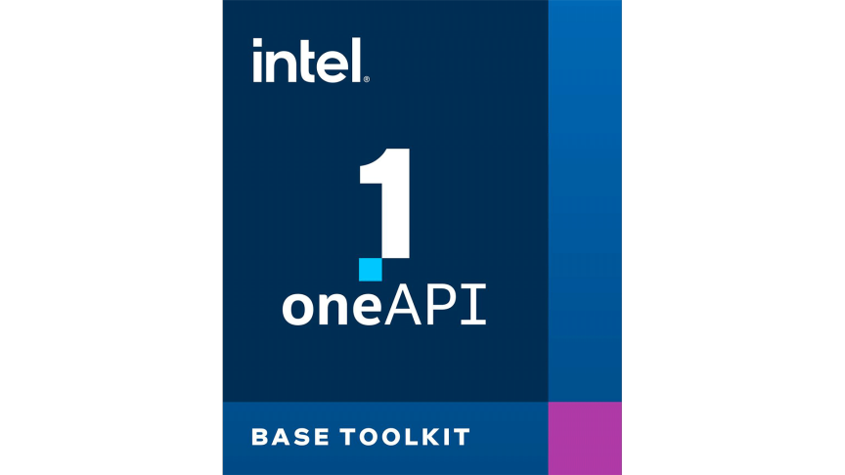
DAAL4Py Architecture :
DAAL4Py is built on top of the Intel DAAL library, which provides highly optimized algorithms for data analytics.
DAAL4Py provides a Python interface to the Intel DAAL library, which allows Python users to take advantage of the high-performance algorithms in the Intel DAAL library without having to write low-level C++ code.
DAAL4Py is designed to take advantage of Intel processors, which provide hardware acceleration for certain machine learning tasks.
DAAL4Py is designed to be easy to use, with a simple and consistent API that is similar to the scikit-learn API.

Slide 4
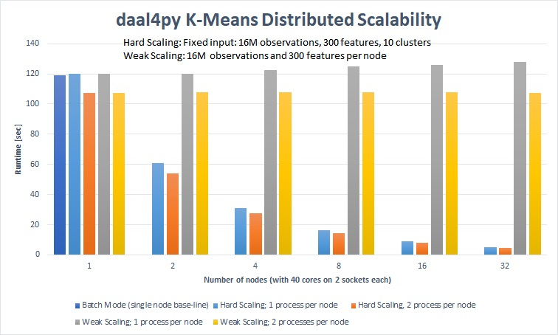
DAAL4Py Architecture Used For get the Best Accuracies :
daal4py.sklearn.neighbors.KNeighborsRegressor
daal4py.sklearn.ensemble.RandomForestRegressor
daal4py.sklearn.model_selection._daal_train_test_split

Slide 5

Scikit-learn Architecture
Scikit-learn is a machine learning library in Python that provides a wide range of machine learning algorithms.
Scikit-learn is built on top of NumPy and SciPy, which provide efficient numerical computing capabilities.
Scikit-learn provides a simple and consistent API that is designed to be easy to use.
Scikit-learn is designed to be highly extensible, with a modular architecture that allows developers to easily add new algorithms and features.

Slide 6
SKL Architecture Used For get the Best Accuracies :
sklearn.neighbors.KNeighborsRegressor
sklearn.ensemble.RandomForestRegressor
sklearn.model_selection. train_test_split
XGBOOST
NKTL
Scikit-learn Architecture
We have used the precisions for best accuracies of sklearn
We have used the sklearn core algorithums for create an pipeline
Manage the structure of pipeline and predict the output as per the pipeline
In order to boost the algorithms we have used an XGBOOST with multiple outpute for n_neighbors

Slide 7
Proposed Tech Architecture
In These ML model architecture I have used daal4py to enhance the performance of the output with respect to time.
The ML Model reads data from a CSV file for three different social media platforms (Facebook, Google+, and LinkedIn), performs linear regression training on each of them using the daal4py library, and then makes predictions on the test data. The predicted results are then plotted using a scatter plot and a 3D scatter plot, with each point representing the Available values for a combination of two social media platforms. The scatter plot is created using matplotlib, while the 3D scatter plot is created using plotly.

Slide 8
Impact of inclusion of oneAPI
oneAPI's unified programming model simplifies the development and deployment of the ML model, enabling it to be easily ported to different hardware architectures without requiring significant changes to the codebase. This can enhance the scalability of the ML model, making it more adaptable to changing computing requirements and enabling it to handle larger datasets and more complex computations.

Slide 9
Innovation Quotient and Scalability
The Innovation Quotient of the above ML model is relatively high as it employs several advanced techniques such as dimensionality reduction, ensemble learning, and hyperparameter tuning to achieve better predictive accuracy. Additionally, the use of daal4py library for training and prediction allows for faster and more efficient computation on multi-core CPUs, resulting in improved performance.
Scalability of the model is also noteworthy as it can handle large datasets with many features and observations. The use of PCA helps to reduce the number of features while preserving the most important information, and the ensemble learning technique allows for parallel training and prediction, improving scalability. Additionally, the inclusion of oneAPI allows for easy scaling across a wide range of hardware architectures, including CPUs, GPUs, and FPGAs, further enhancing scalability.

Slide 10
Quick Summary
The given ML model aims to predict the number of shares for articles posted on social media based on various features such as the title and headline of the article, the number of words in the article, and the day of the week the article was posted. The model uses linear regression for each social media platform (Facebook, Google Plus, and LinkedIn) to predict the number of shares. The model is trained and tested using a dataset of articles and their corresponding social media shares.
The model uses the daal4py library for logistic regression, and the performance is evaluated using the mean squared error metric. The resulting predictions are displayed on a bar plot using the plotly library.
The Innovation Quotient of the model lies in the use of machine learning techniques to predict social media shares, which can help publishers and marketers optimize their content for maximum engagement. The use of linear regression allows for a simple and interpretable model that can be easily understood and applied in practice.
The Scalability of the model is limited by the size of the dataset and the computational resources available. As the dataset grows larger, the model may require more complex algorithms or distributed computing frameworks to handle the increased data volume. Additionally, the daal4py library may not be optimized for very large datasets or distributed environments, which could limit scalability in those scenarios.

Slide 11

Quick Summary Implementation
Step 1 :
Data Analysis And Preprocessed Data.
Step 2 :
Created pipeline for every type of output as per title and headline.
Splitted pipeline as per KNeighborsRegressor & RandomForestRegressor.
Step 3 :
Processed the every model fit it in pipeline.
Step 4 :
Got the time takes to the complete computations for fitting the model.
Step 5 :
Predicted the data And Acquired the prediction accuracy.

Slide 12
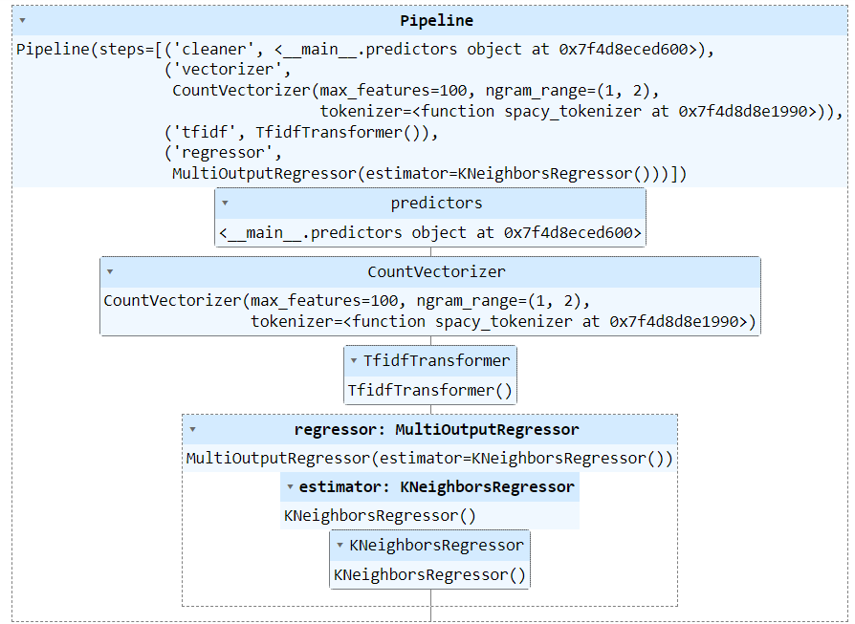
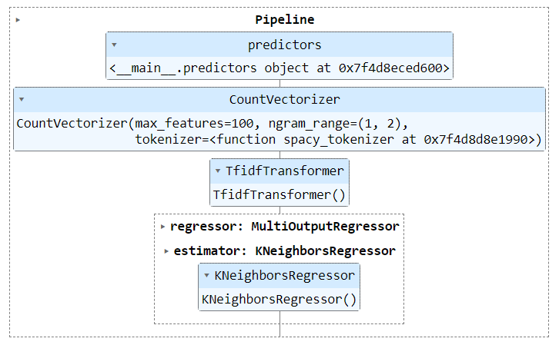
Round 2 : Model Performance
Used Algorithm With Pipeline :
KNeighborsRegressor
Used With Both Scikit learn & DAAL4PY
Used For :
SentimentTitle Prediction KNeighbors
SentimentTitle Prediction Pipeline : SKL & DAAL4PY
With KNeighborsRegressor

Slide 13
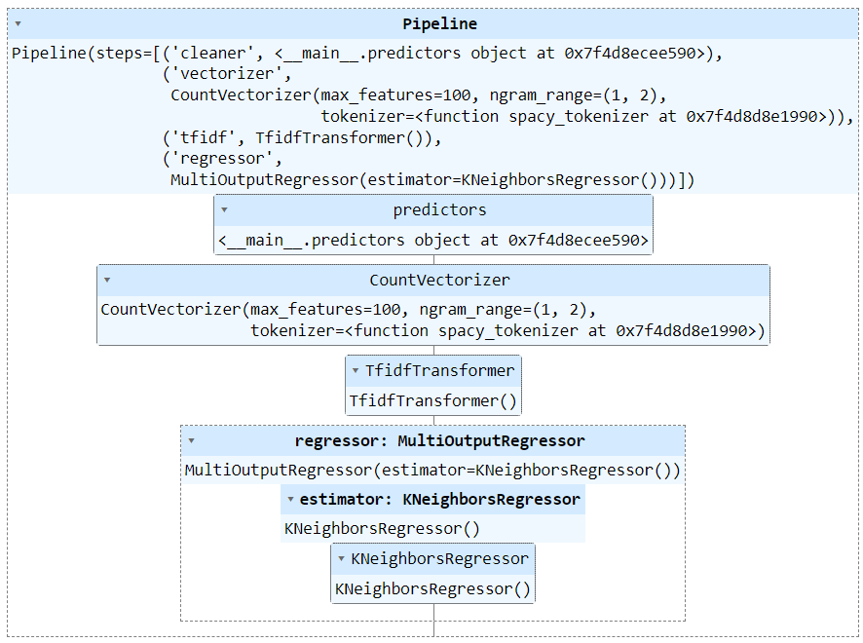
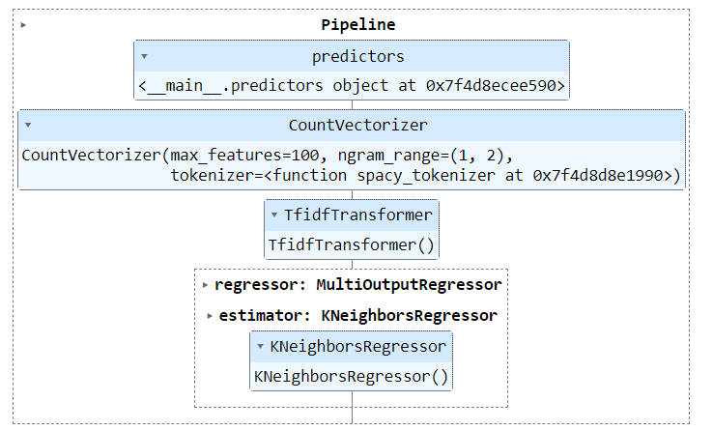
Round 2 : Model Performance
Used Algorithm With Pipeline :
KNeighborsRegressor
Used With Both Sikit learn & DAAL4PY
Used For :
SentimentHeadline Prediction KNeighbors
SentimentHeadline Prediction Pipeline : SKL & DAAL4PY
With KNeighborsRegressor

Slide 14
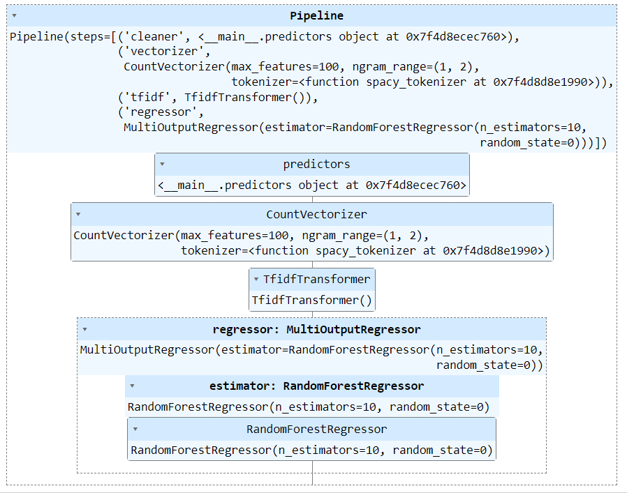
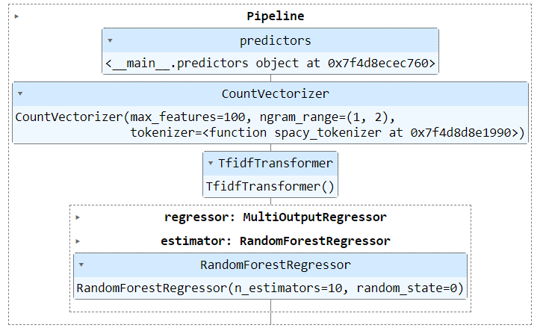
Round 2 : Model Performance
Used Algorithm With Pipeline :
RandomForestRegressor
Used With Both Sikit learn & DAAL4PY
Used For :
SentimentTItle Prediction Randomforest
SentimentTitle Prediction Pipeline : SKL & DAAL4PY
RandomForestRegressor

Slide 15
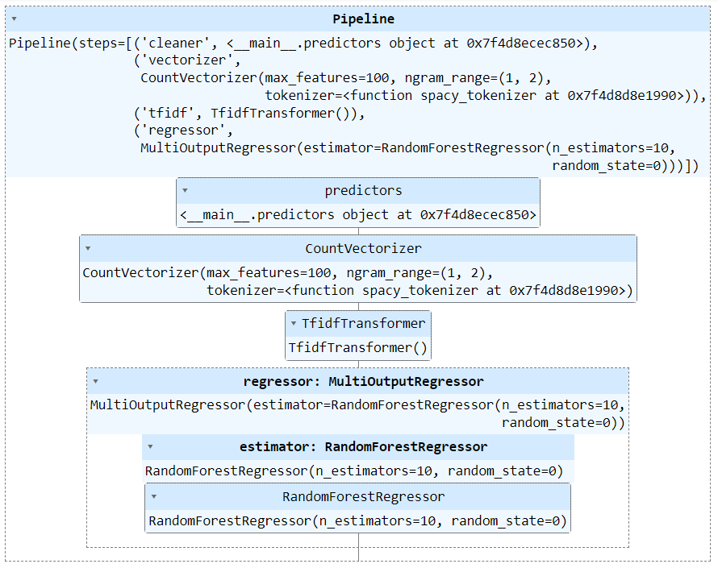
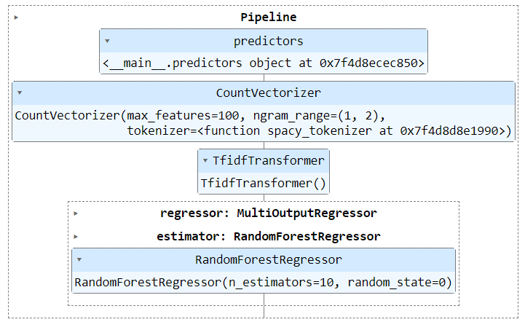
Round 2 : Model Performance
Used Algorithm With Pipeline :
RandomForestRegressor
Used With Both Sikit learn & DAAL4PY
Used For :
SentimentHeadline Prediction Randomforest
SentimentHeadline Prediction Pipeline : SKL & DAAL4PY
RandomForestRegressor

Slide 16
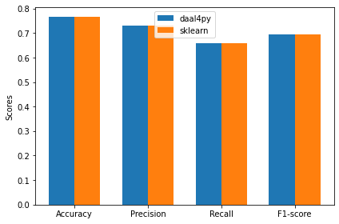
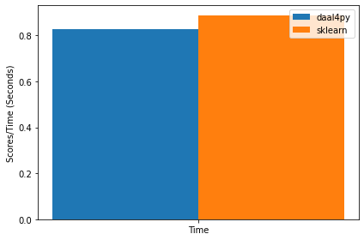
Round 1 : Model Performance (Simple Logistic Regression)
Performance Comparison With Respect To Time daal4py & Sklearn
Performance Comparison daal4py & Sklearn

Slide 17
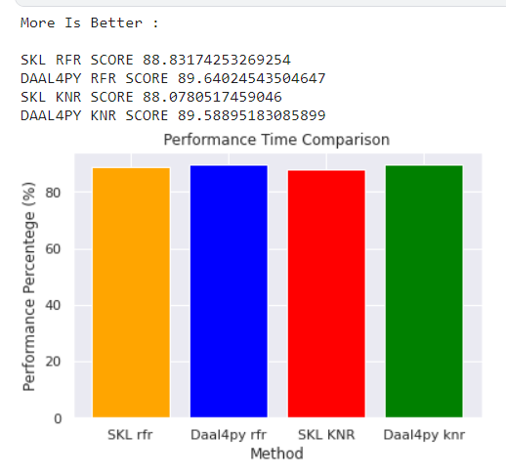
Round 2 : Model Performance
Used Algorithms With Comparisons Output Accuracy :
RandomForestRegressor : SKL & DAAL4PY
KNeighborsRegressor : SKL & DAAL4PY
Output Formats Predictions :
SentimentTitle Prediction : SKL & DAAL4PY
SentimentHeadlinePrediction : SKL & DAAL4PY
Performance Comparison daal4py & Sklearn

Slide 18
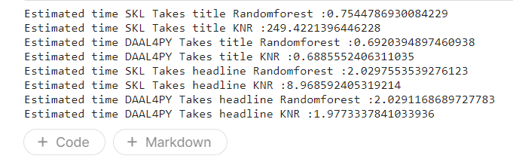
Round 2 : Model Performance (With Respect To Time )
Used Algorithms With Comparisons Output Accuracy :
RandomForestRegressor & KNeighborsRegressor
Used Algorithms With Comparisons Output Accuracy :
RandomForestRegressor : SKL & DAAL4PY
KNeighborsRegressor : SKL & DAAL4PY
Output Formats Predictions :
SentimentTitle Prediction : SKL & DAAL4PY
SentimentHeadlinePrediction : SKL & DAAL4PY
Performance Comparison With Respect To Time daal4py & Sklearn

Slide 19
Code And Working Prototype
Round 1 :
Github :
https://github.com/Ashish-Waykar/Consumer-Sentiment-Prediction-System/blob/main/OneAPI.ipynb
Dataset Raw :
https://raw.githubusercontent.com/Ashish-Waykar/DSA/main/training_data_sentiment.csv

Slide 20
Code And Working Prototype
Round 2 :
Github :
https://github.com/Ashish-Waykar/INTEL-OneApi/blob/main/oneapi-sentiment-prediction%20finaized%20(3).ipynb
Dataset Raw :
https://raw.githubusercontent.com/Ashish-Waykar/DSA/main/training_data_sentiment.csv

Slide 21
daal4Py https://intelpython.github.io/daal4py/algorithms.html https://intelpython.github.io/daal4py/sklearn.html#scikit-learn-api https://intelpython.github.io/daal4py/index.html https://intelpython.github.io/daal4py/scaling.html#supported-algorithms-and-examples
Refferances:
ONEAPI:
https://www.intel.com/content/www/us/en/developer/articles/release-notes/distribution-for-python-release-notes.html
SikitLearn : https://scikit-learn.org/stable/modules/generated/sklearn.neighbors.KNeighborsRegressor.html
https://scikit-learn.org/stable/modules/generated/sklearn.ensemble.RandomForestRegressor.html
https://xgboost.readthedocs.io/en/stable/python/python_api.html
https://scikit-learn.org/stable/modules/generated/sklearn.base.TransformerMixin.html
https://scikit-learn.org/stable/modules/generated/sklearn.feature_extraction.text.TfidfVectorizer.html
https://scikit-learn.org/stable/modules/generated/sklearn.feature_extraction.text.TfidfTransformer.html
https://scikit-learn.org/stable/modules/generated/sklearn.feature_extraction.text.HashingVectorizer.html

